Slide 1
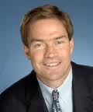
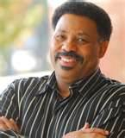


Men’s Conference March 23, 2013
New Antioch Baptist Church - Randallstown, MD
PLUS:
● 18 Different Seminars
● “Iron Man Praise Band”
● Men’s Resources
● Masculine Camaraderie
$39 per man in a 10+ group
$19 men ages 13 – 22
$19 active duty military
Pastors attend free
Disabled Vets attend free
Saturday March 23, 2013
8:30 am – 4:55 pm
JEFF KEMP
Keynoter
Former NFL QB for eleven seasons and currently Vice President of Family Life Ministry located in Little Rock, Arkansas.
Dr. TONY EVANS
Keynoter
Sr. Pastor, Oak Cliff Bible Church, Dallas TX; best-selling author, and one of America’s most renown and sought-after speakers.
For additional information and registration go to: WWW.WACMM.ORG

